Slide 1

Analyzing Walmart Sales
Insights on Trends, Holidays, and Performance
by Niko prabowo

Slide 2
Business Questions
1. How do holidays impact weekly sales?
2. Does air temperature affect consumer spending?
3. Which stores perform best over time?
4. Are there seasonal trends or patterns in sales?
5. Do fuel prices, CPI, and unemployment influence revenue?

Slide 3
Data Overview
Scope: Weekly sales data for multiple Walmart stores across several years, including holiday and economic indicators.
Rows: ~6435 (one row per store per week)
Outliers: ~7% of weeks are flagged as outliers (most in holiday weeks)
Key Characteristics
Holiday weeks make up ~7% of data but contribute ~38% of extreme sales events.
Seasonal trends: Winter & Fall dominate outlier weeks (holiday and peak seasons).
Temperature is categorized for trend analysis: Cold, Mild, Warm, Hot.
Multiple time dimensions allow analysis by week, month, season, and year.
Economic indicators (Fuel Price, CPI, Unemployment) included for correlation with sales.

Slide 4
Data Cleaning & Transformation
Converted the Date column to datetime format
Store converted to a categorical variable to optimize memory and enable grouping.
Holiday_Flag converted to categorical, and a new column Holiday created for clarity
Created a categorical temperature variable Temp_Bin
Defined seasons based on the month
Monthly sales per store: Aggregated weekly sales to monthly totals
Holiday impact: Calculated average weekly sales for holiday vs non-holiday weeks

Slide 5
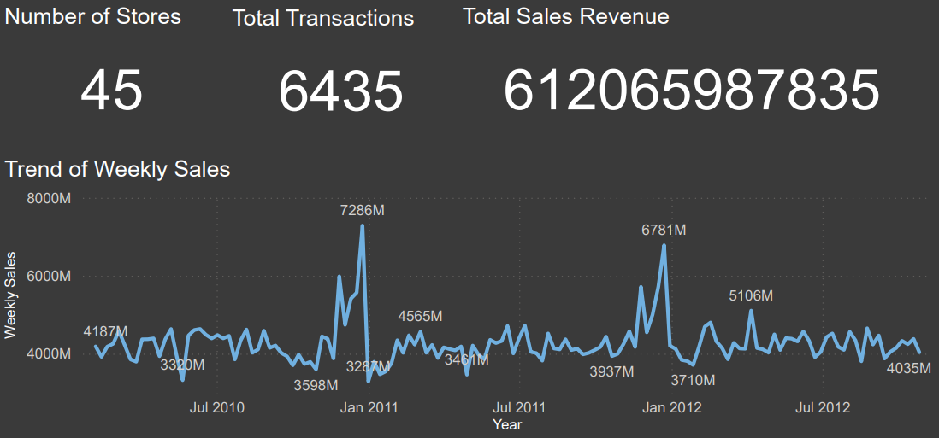
Sales performances

Slide 6
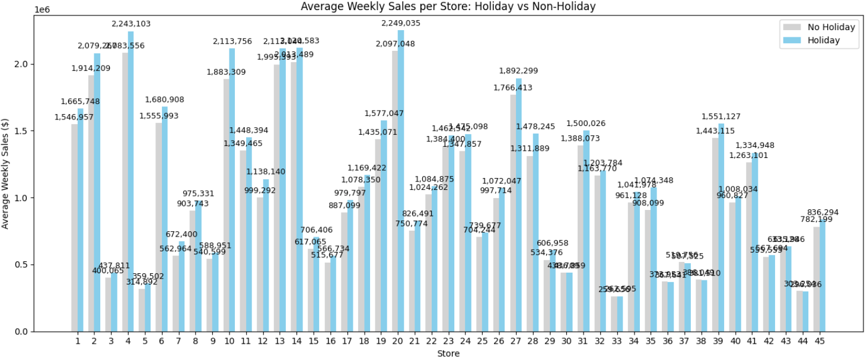
How do holidays impact weekly sales?
Holiday weeks have 7.84% higher average sales than non-holiday weeks.

Slide 7
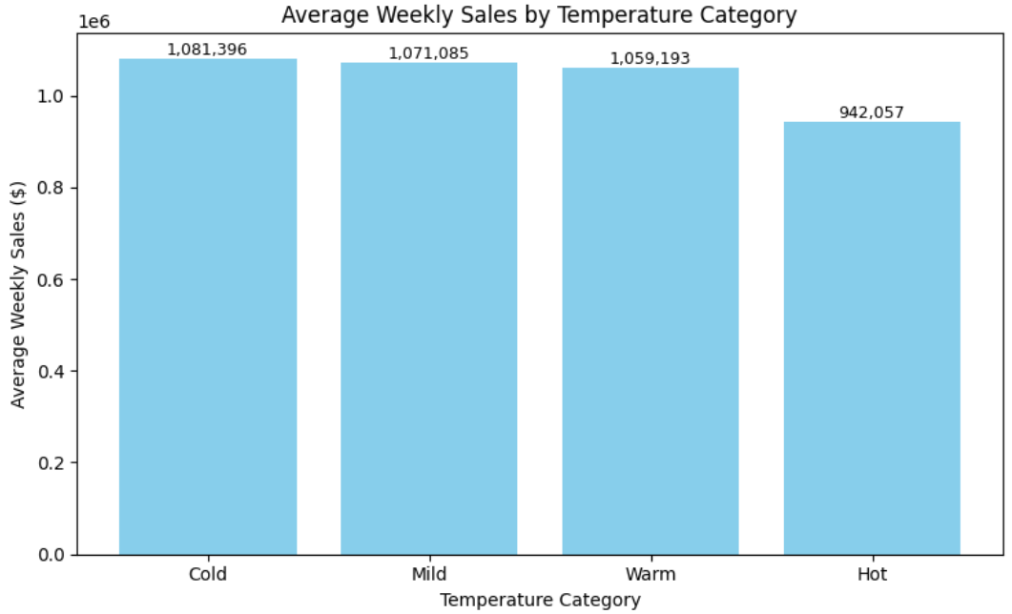
Does air temperature affect consumer spending?
Average weekly sales are slightly higher during colder temperatures (Cold and Mild) and decline as temperatures rise (Warm and Hot). The difference between the highest (Cold) and lowest (Hot) average weekly sales is about 139,339 USD, indicating a modest decline in sales at higher temperatures.

Slide 8
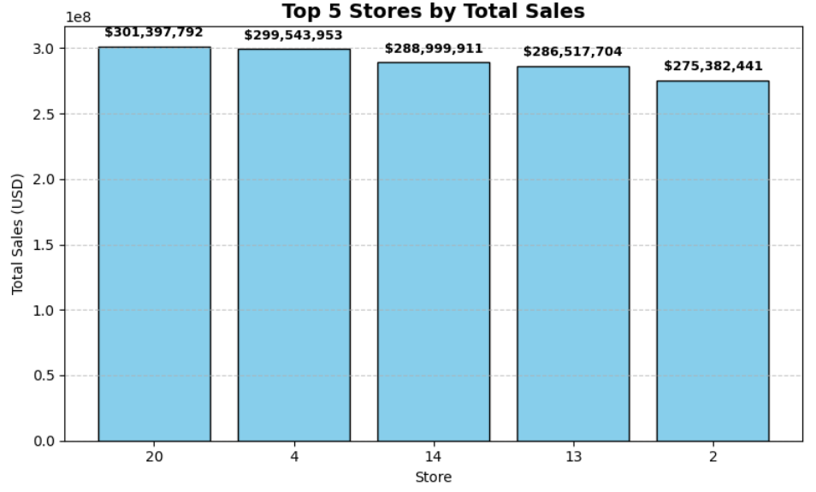
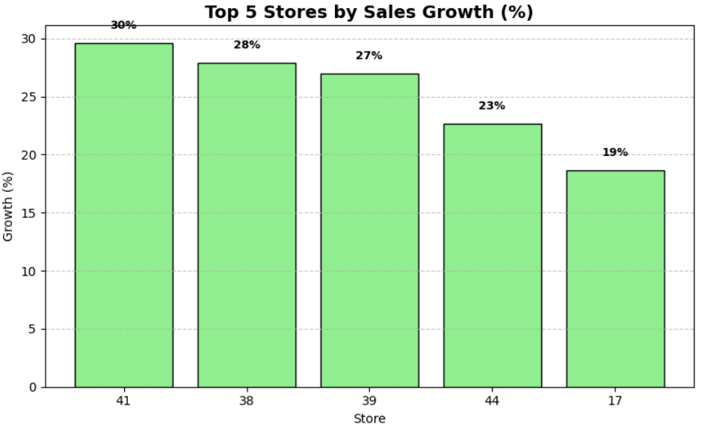
Which stores perform best over time?
Stores 24, 4, and 14 consistently generated the highest revenue, making them the largest contributors to overall Walmart sales. While these stores may not have the highest total sales, they are showing rapid growth, suggesting strong potential for future revenue increases.
Insight: High-growth stores could be prime candidates for expansion, additional promotions, or targeted marketing, as they demonstrate rising customer demand over time.

Slide 9
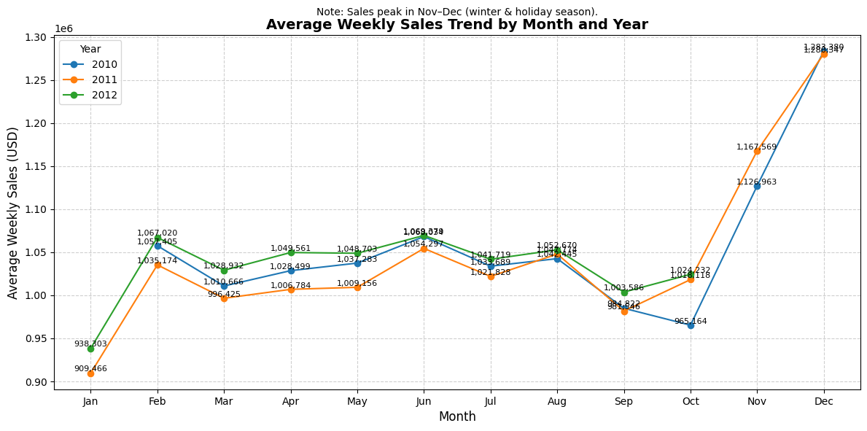
Are there seasonal trends or patterns in sales?
Sales peak in Nov–Dec due to holiday season and winter promotions. Then, lowest sales observed in Jan and Sep, indicating post-holiday slow periods.
Pattern is consistent across all three years (2010, 2011, 2012), highlighting predictable seasonal behavior.

Slide 10
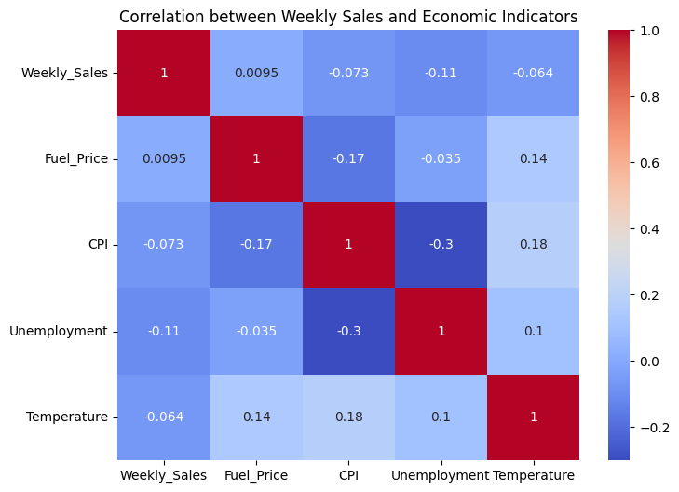
Do fuel prices, CPI, and unemployment influence revenue?
Fuel prices have no significant impact on weekly sales. CPI and unemployment negatively influence sales, but the magnitude is small. Overall, these macroeconomic factors alone do not strongly explain sales variation. Other drivers (e.g., holidays, promotions, store location) likely have more influence.

Slide 11
In the end..
Conclusion
Holidays and seasonal peaks (Nov–Dec) drive sales.
Top stores (24, 4, 14) consistently perform well; some high-growth stores show strong potential.
Fuel prices, CPI, and unemployment have minimal impact on sales.
Suggestions
Focus marketing and inventory on holiday and peak seasons.
Support high-growth stores with promotions or expansion.
Monitor economic indicators but prioritize store- and holiday-level strategies.

Slide 12
Thanks
Niko prabowo (nikoberwibowo@gmail.com)

